Slide 1



UNIT 5;
My home and healthy living
Holiday photos

Slide 2
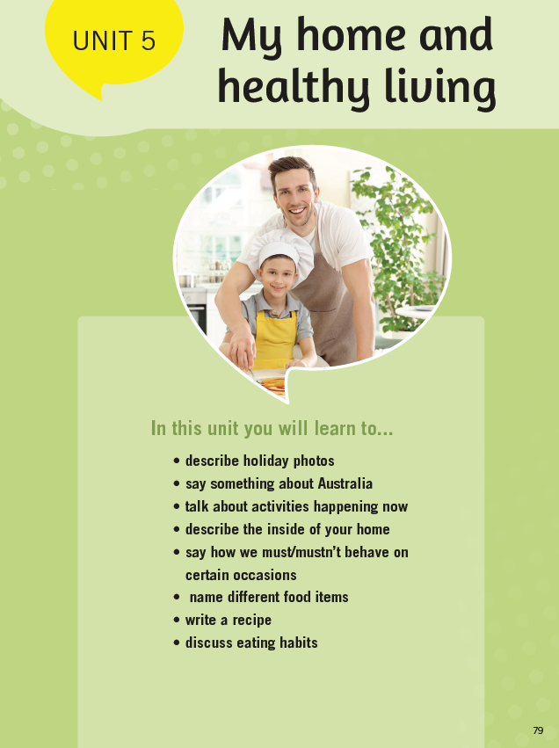
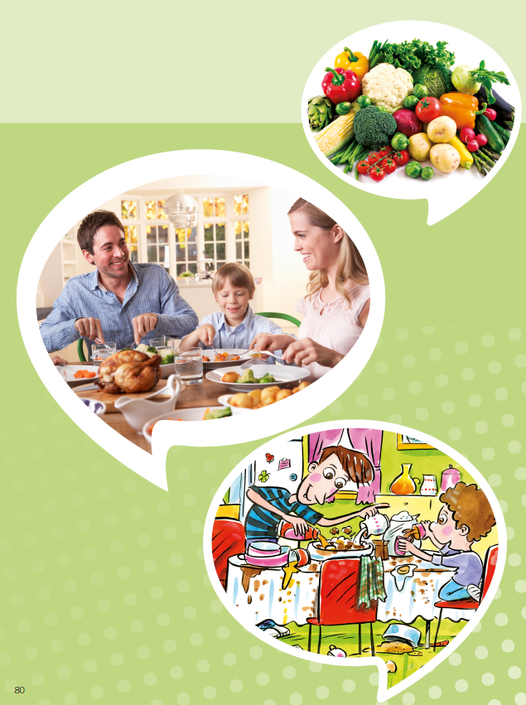
U ovoj cjelini naučit ćeš
opisati fotografije sa odmora,
naučit ćeš reći nešto više o Australiji,
razgovarat ćeš o aktivnostima koje se događaju upravo sada,
opisat ćeš unutrašnjost vlastitog doma,
reći ćeš kako se moramo ponašati u određenim situacijama,
imenovat ćeš prehrambene namirnice,
napisati jednostavan recept i
raspravljati o prehrambenim navikama

Slide 3
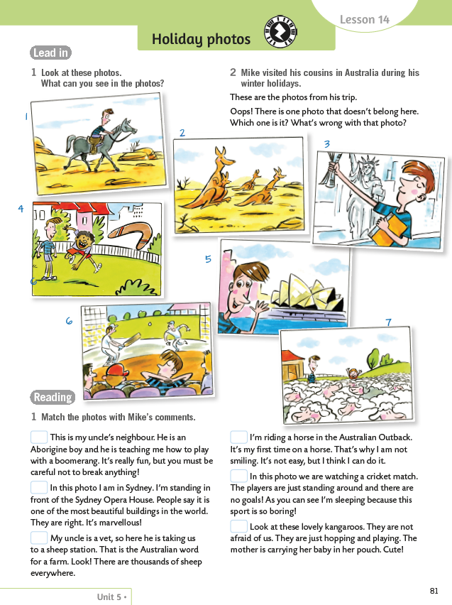
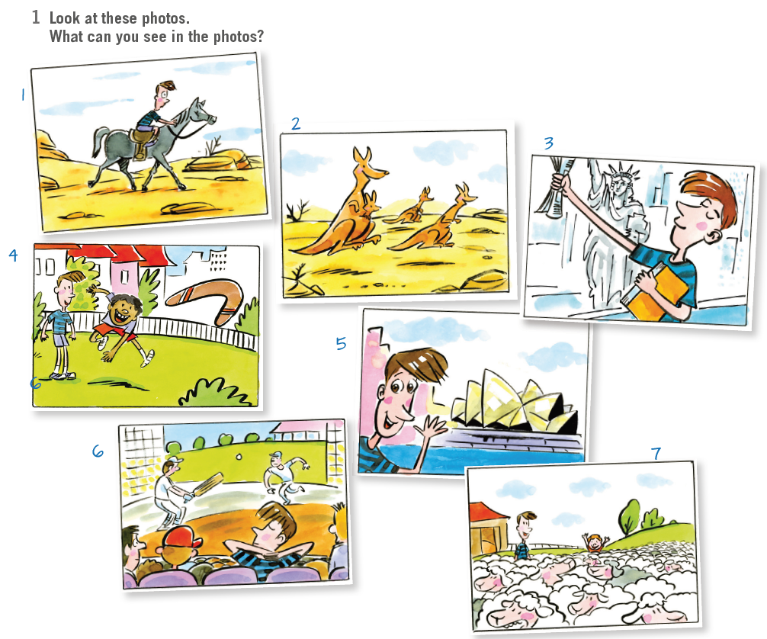
Book, page 81.
Look at these photos. What can you see in the photos?
1 A boy is riding a horse.
2 Some kangaroos are hopping.
3 A boy is standing in front of the Statue of Liberty.
4 Two boys are playing with a boomerang.
5 A boy is standing in front of the Sydney Opera house.
6 A boy is watching a cricket match.
7 Two boys are visiting a sheep farm.

Slide 4

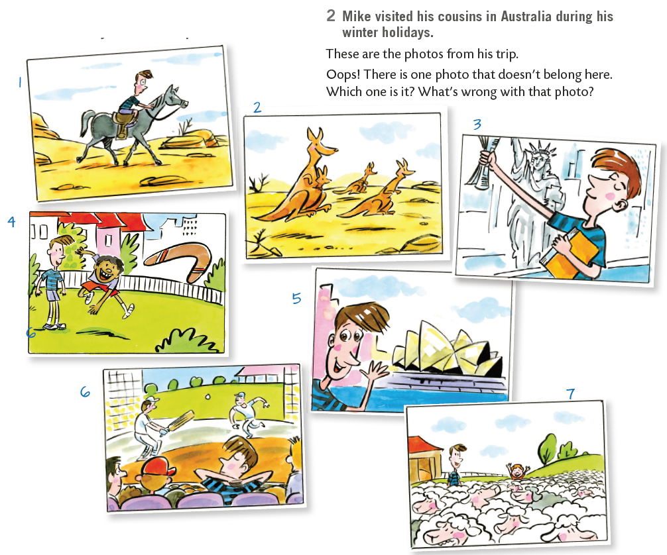
Mike visited his cousins in Australia during his winter holidays. These are the photos from his trip. Oops! There is one photo that doesn’t belong here. Which one is it? What’s wrong with that photo?

Slide 5
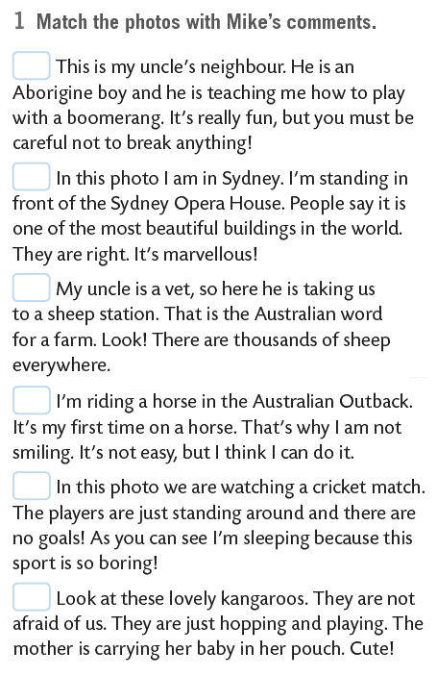
Match the photos with Mike’s comments.
4
5
7
1
6
2

Slide 6
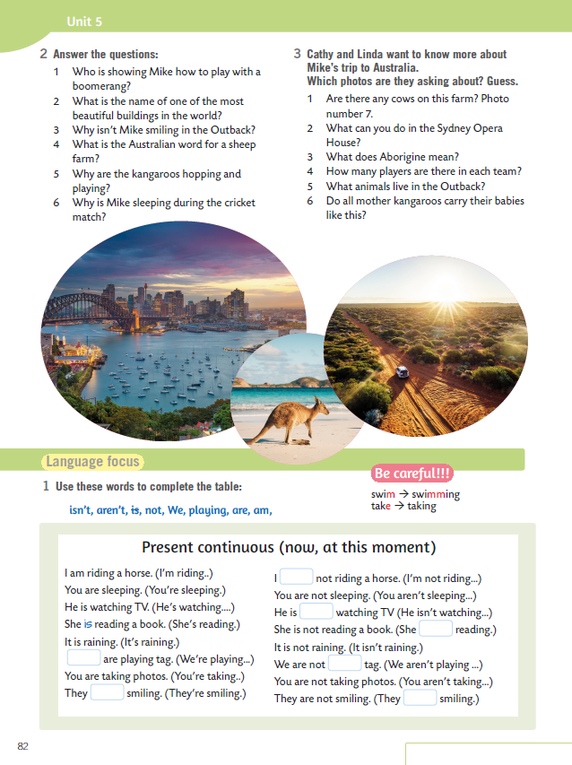
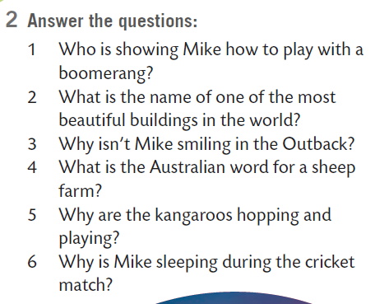
On the next page...
Answer the questions.
1 An Aborigine boy is showing Mike how to play with a boomerang.
2 The Sydney Opera House is one of the most beautiful buildings in the world
3 Mike isn’t smiling because it’s his first time on a horse and it’s not easy.
4 Sheep station is the Australian word for a sheep farm.
5 The kangaroos hopping and playing because they are not afraid.
6 Mike is sleeping during the cricket match because he thinks that cricket is boring.

Slide 7
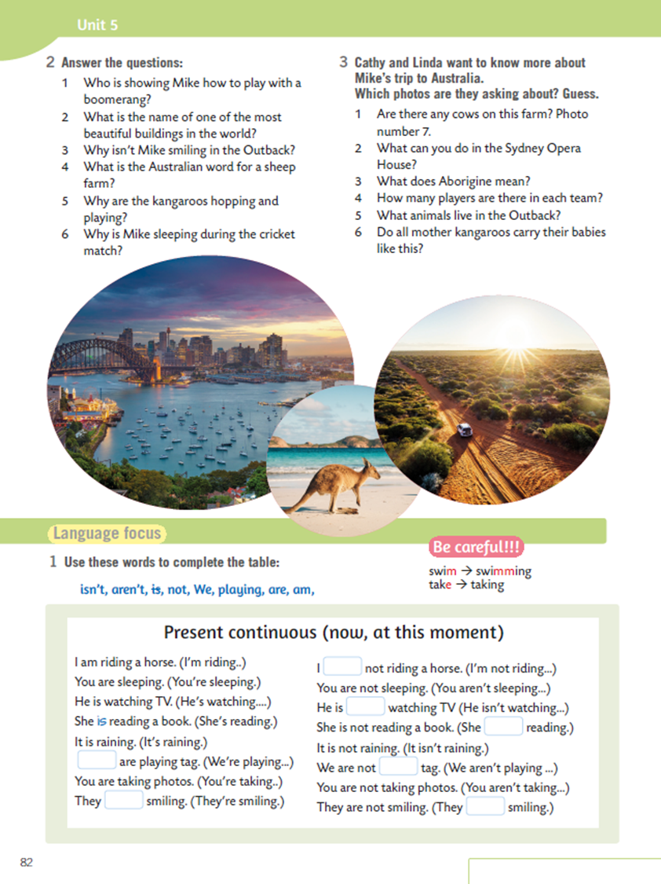
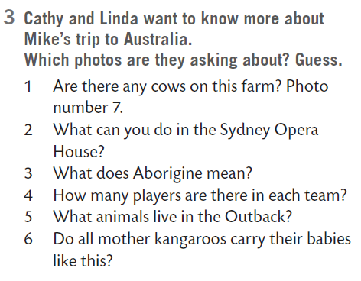
Cathy and Linda want to know more about Mike’s trip to Australia. Which photos are they asking about? Guess.
Photo number 5.
4
6
2
2

Slide 8
Learn more about Australia here:
https://www.e-sfera.hr/dodatni-digitalni-sadrzaji/5a4425ad-f208-492b-a588-40f8723f2c30/assets/video/australia.mp4

Slide 9
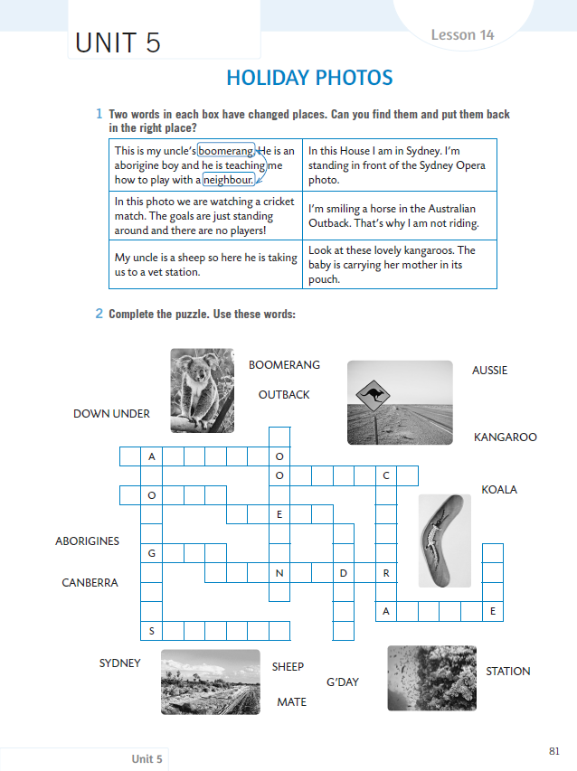
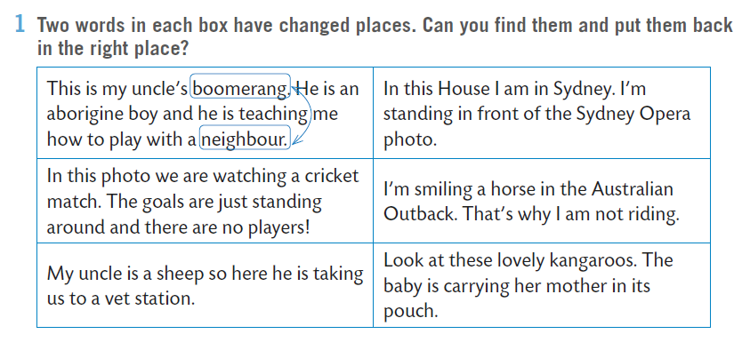

WB, page 81.
Two words in each box have changed places. Can you find them and put them back in the right place?

Slide 10
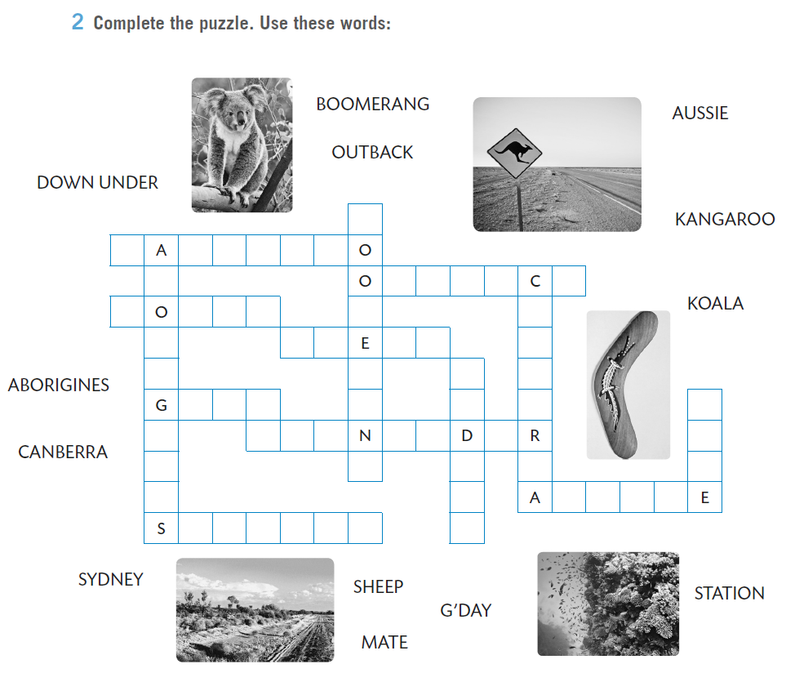
Complete the puzzle. Use these words.
B
M
R
A
G

Slide 11
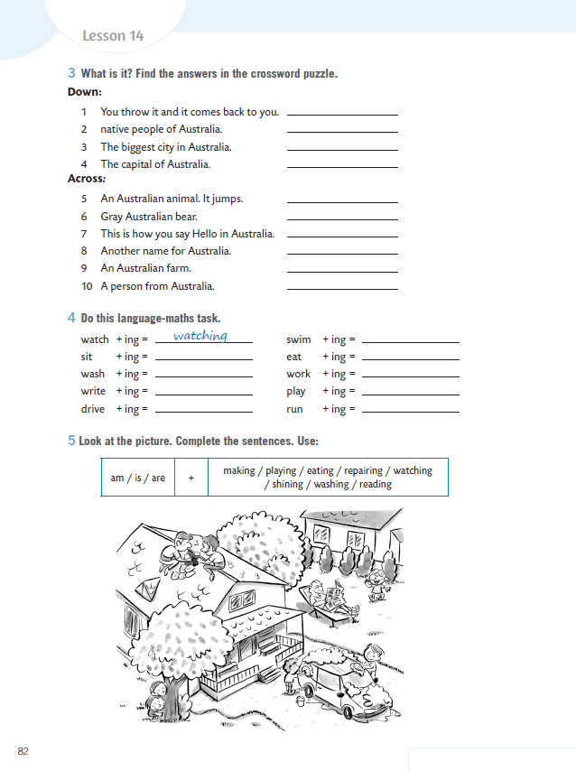
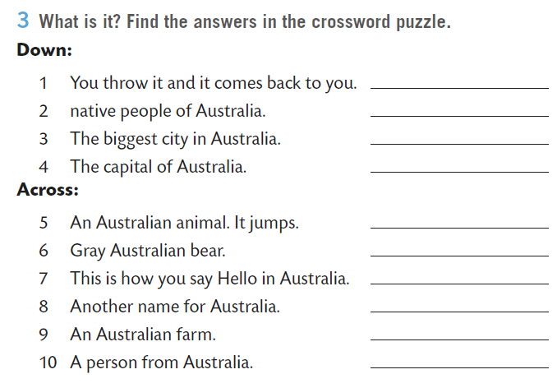
WB p. 82
What is it? Find the answers in the crossword puzzle.
Boomerang
Do the quiz:
https://wordwall.net/resource/1555480

Slide 12

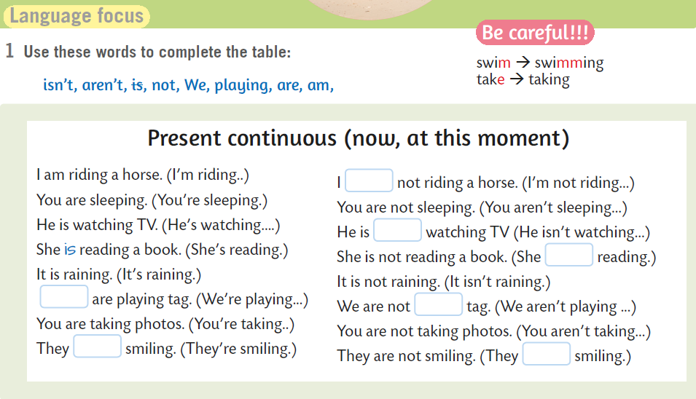
Book, page 82.
Complete the table.
Use LANGUAGE FOCUS to fill in.
am
not
isn’t
We
playing
are
aren’t

Slide 13
Ovo glagolsko vrijeme zove se PRESENT CONTINUOUS.
Koristimo ga za radnje koje se odvijaju now, at this moment – dakle, SADA tj. U OVOM TRENUTKU.
Npr. "Upravo gledam televiziju", ili "Iva trenutno priča na telefon", itd.
I am watching TV at the moment.
Iva is talking on the phone right now.
Na početku rečenicu najčešće se nalazi subjekt, odnosno vršitelj radnje.
U prethodno navedenim primjerima subjekti, odnosno vršitelji radnje su: ja u prvoj rečenici, i Iva u drugoj rečenici.
Nakon subjekta slijedi pomoćni glagol (glagol koji dolazi prije glavnog glagola), u Present Continuousu je pomoćni glagol TO BE (BITI) – u 1. licu jednine to će biti AM, u 3. licu jednine IS, a u svim ostalim licima ARE.
Nakon pomoćnog glagola slijedi glavni glagol, te se na njega dodaje nastavak -ing.

Slide 14
Prilikom izražavanja negacije, koristimo negaciju not.
Primjer: I am not doing my homework at the moment. ( Ja trenutno ne pišem zadaću).
BE CAREFUL:
Ako glagol završava na jedan suglasnik ispred kojeg stoji kratak, naglašen samoglasnik, krajnji se suglasnik ispred –ing udvostručava:
stop – stopping
Krajnje –l se uvijek udvostručava:
travel – travelling
Ukoliko glagol završava na –e, to -e se gubi i dodaje se nastavak –ing:
come – coming
take – taking
Ukoliko glagoli završavaju na –ie, nastavak -ie prelazi u y i dodaje se nastavak – ing:
die – dying
lie – lying

Slide 15
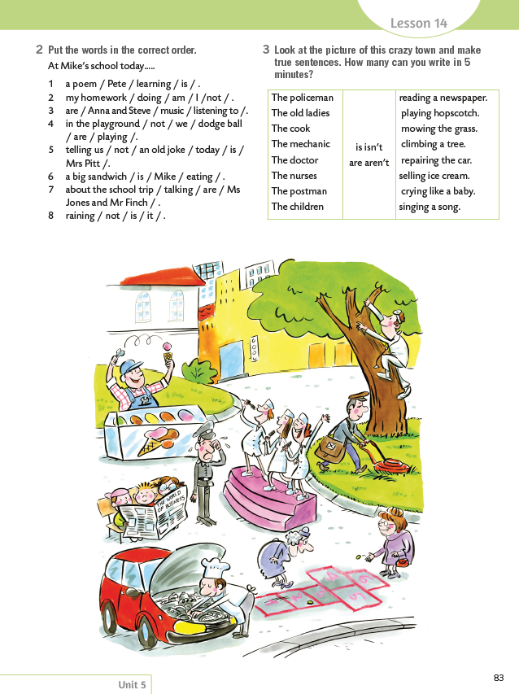
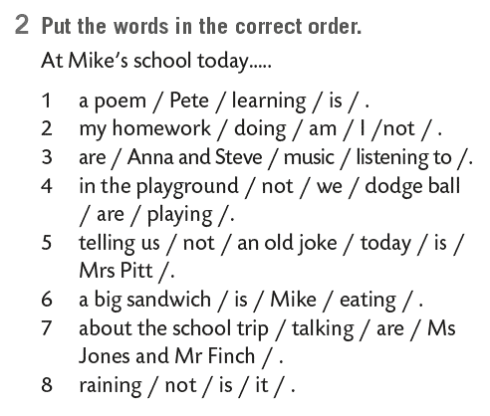
Book, page 83.
Put the words in the correct order.
1 Pete is learning a poem.
2 I am not doing my homework.
3 Anna and Steve are listening to music.
4 We are not playing dodge ball in the playground.
5 Mrs Pitt is not telling us an old joke.
6 Mike is eating a big sandwich.
7 Ms jones and Mr Finch are talking about the school trip.
8 It is not raining.

Slide 16

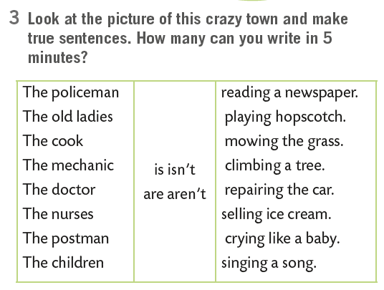
Look at the picture of this crazy town and make true sentences. How many can you write in 5 minutes?
The policeman is crying like a baby.

Slide 17

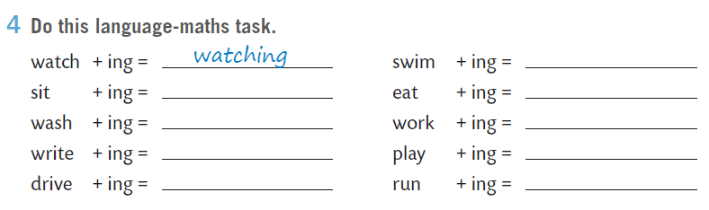
Open your exercise book, page 82.
Do this language-maths task.
sitting
washing

Slide 18
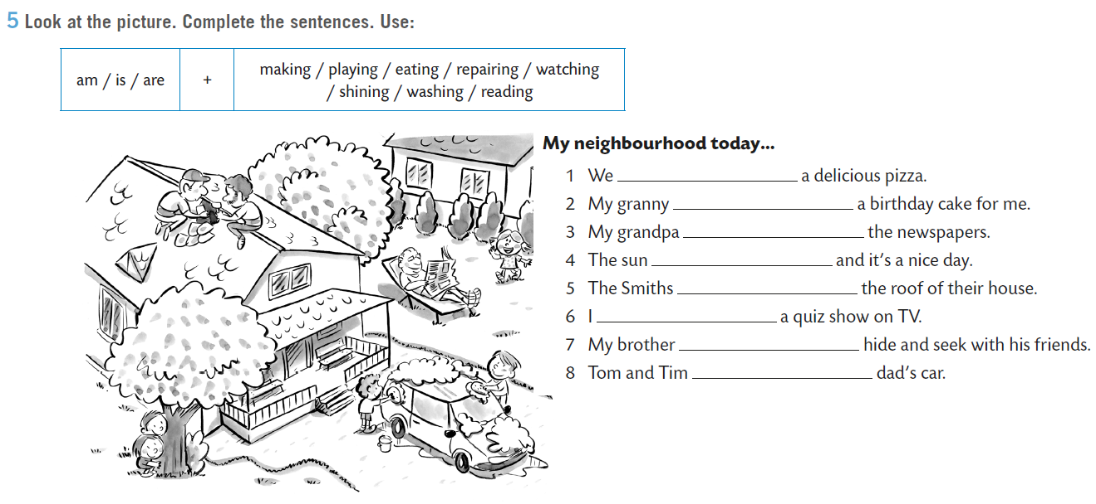
Look at the picture. Complete the sentences.
are eating
is making

Slide 19
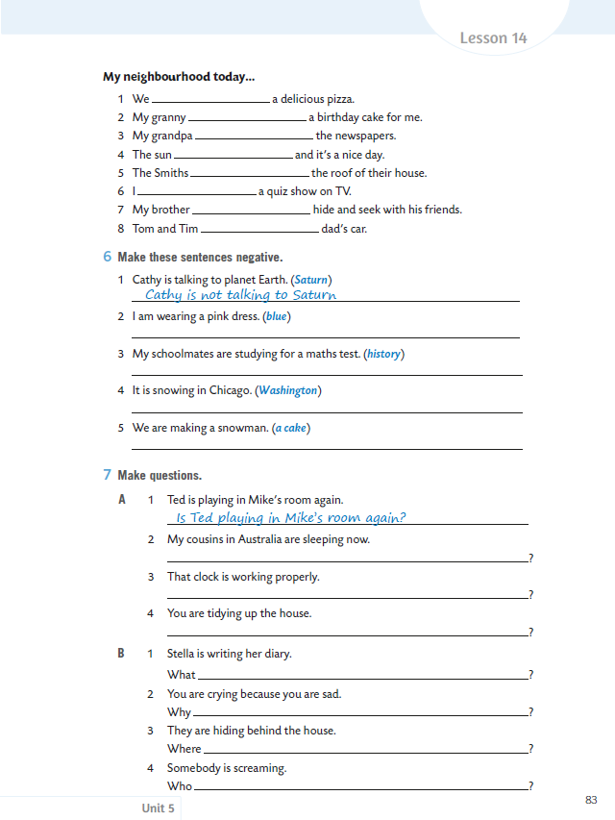
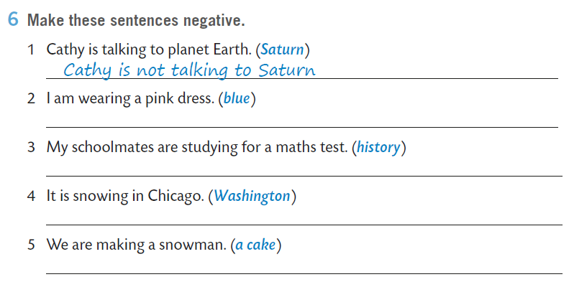
On the next page...
Make these sentences negative.
I am not wearing a blue dress.
Practice here:
https://wordwall.net/resource/275278

Slide 20
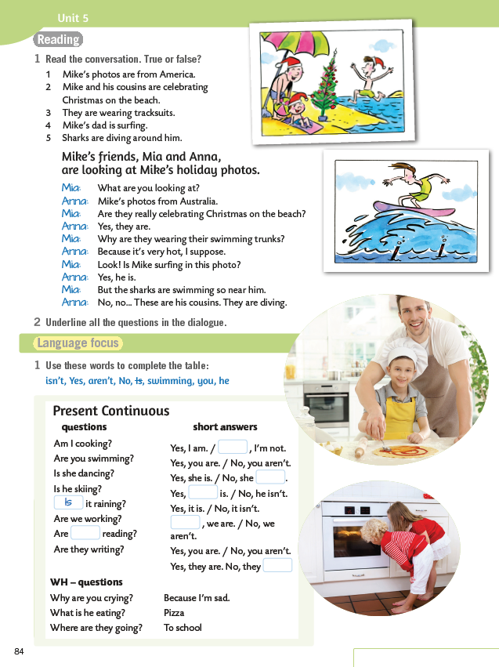
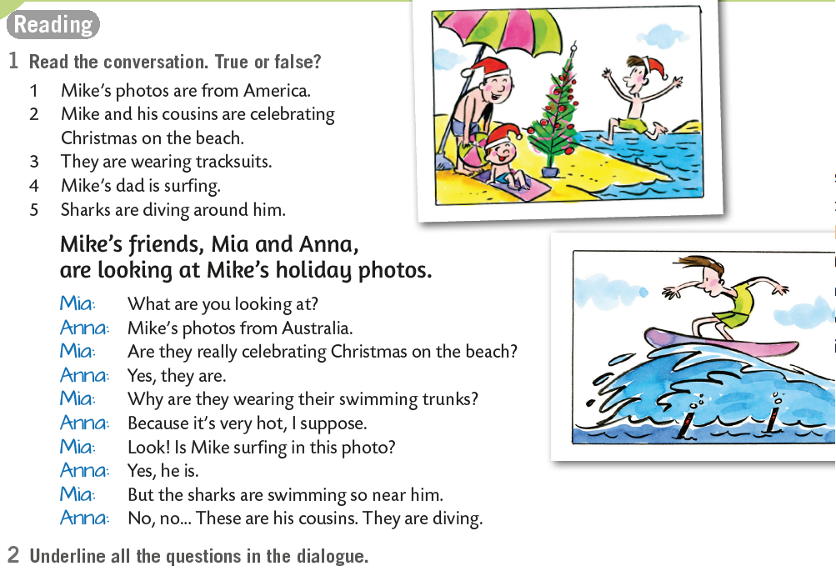
Book, page 84.
Underline all the questions in the dialogue.
Podcrtaj sva pitanja u dijalogu.
F
T
F
F
F

Slide 21

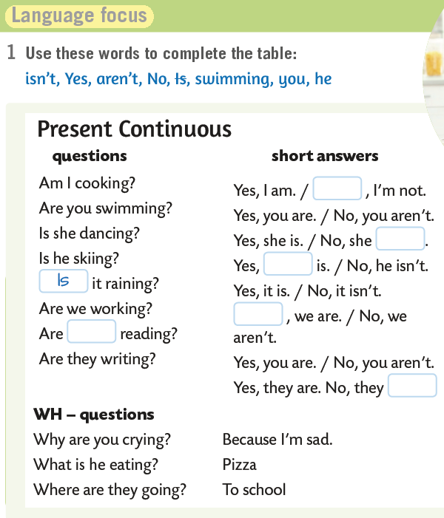
Complete the table.
Sjećaš li se pravila za pravila za PRESENT CONTINUOUS?
Kako ćeš izreći Ja kuham?
I am cooking.
A kako ćeš postaviti pitanje?
Am I cooking?
Primjećuješ li da si samo zamijenio mjesta pomoćnog glagola i subjekta?
Kod upitnog oblika, pomoćni glagol TO BE mijenja mjesto sa subjektom, odnosno vršiteljem radnje, dok ostatak rečenice ostaje nepromijenjen!
Kako ću onda pitati ŠTO ja kuham?
What am I cooking?
Dakle, samo ispred pomoćnog glagola stavljam upitnu riječ WH~!
No
isn’t
he
Yes
you
aren’t

Slide 22
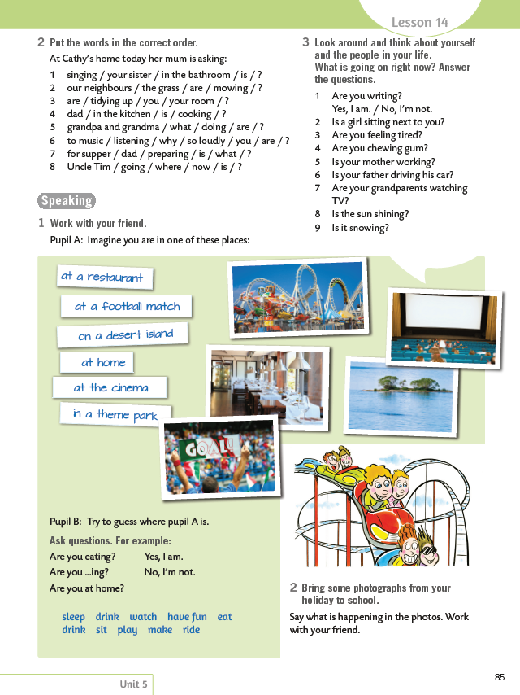
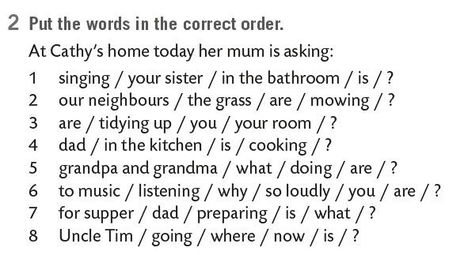
On the next page...
Put the words in the correct order.
1 Is your sister singing in the bathroom?
2 Are our neighbours mowing the grass?
3 Are you tidying your room?
4 Is dad cooking in the kitchen?
5 What are grandpa and grandma doing?
6 Why are you listening to music so loudly?
7 What is dad preparing for supper?
8 Where is uncle Tim going now?
Practice here:
https://www.e-sfera.hr/dodatni-digitalni-sadrzaji/5a4425ad-f208-492b-a588-40f8723f2c30/assets/interactivity/self-check_1/index.html

Slide 23

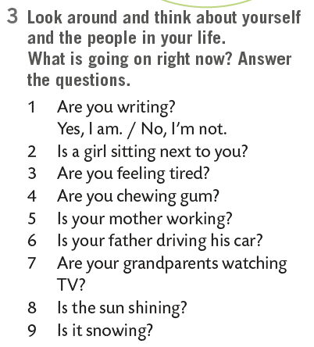
Look around and think about yourself and the people in your life. What is going on right now? Answer the questions.

Slide 24
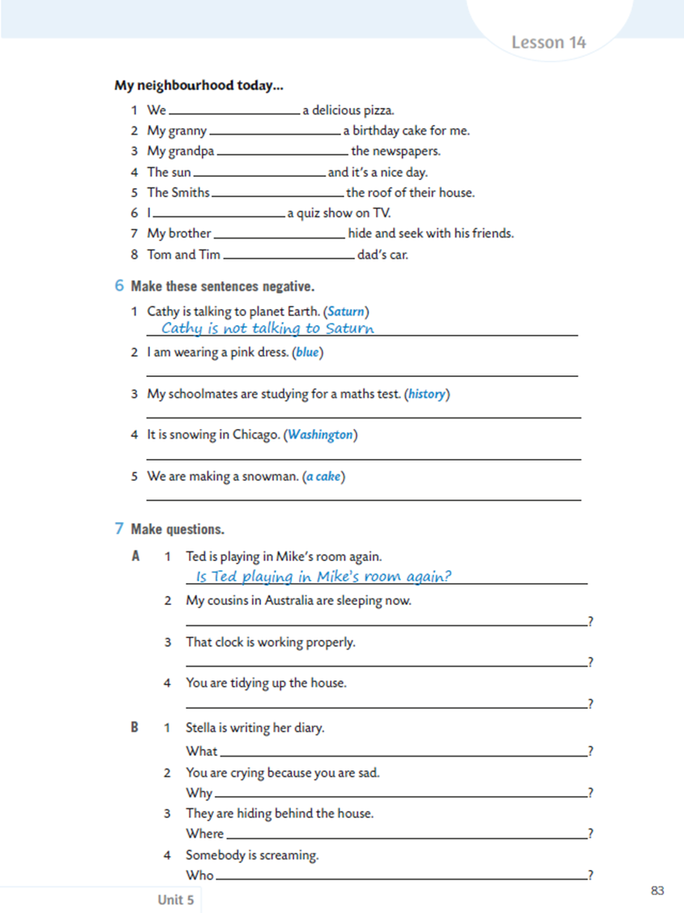
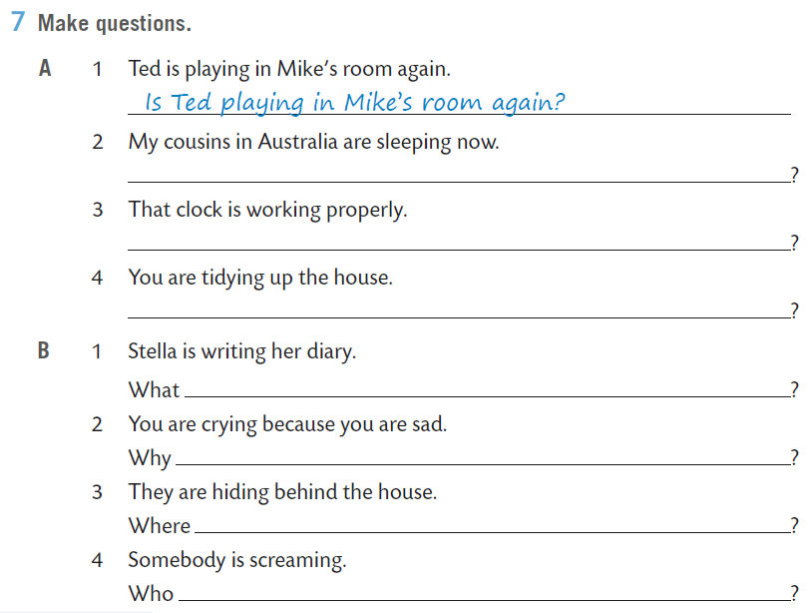
Open your exercise book, page 83.
Make questions.
Are my cousins in Australia sleeping now
is Stella writing

Slide 25
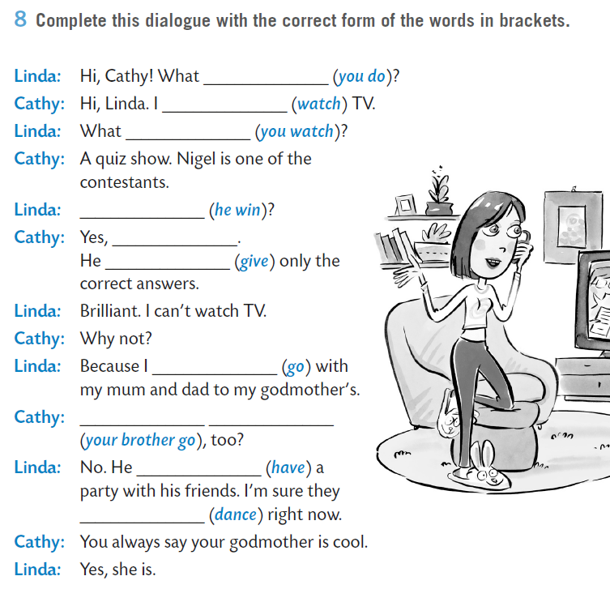
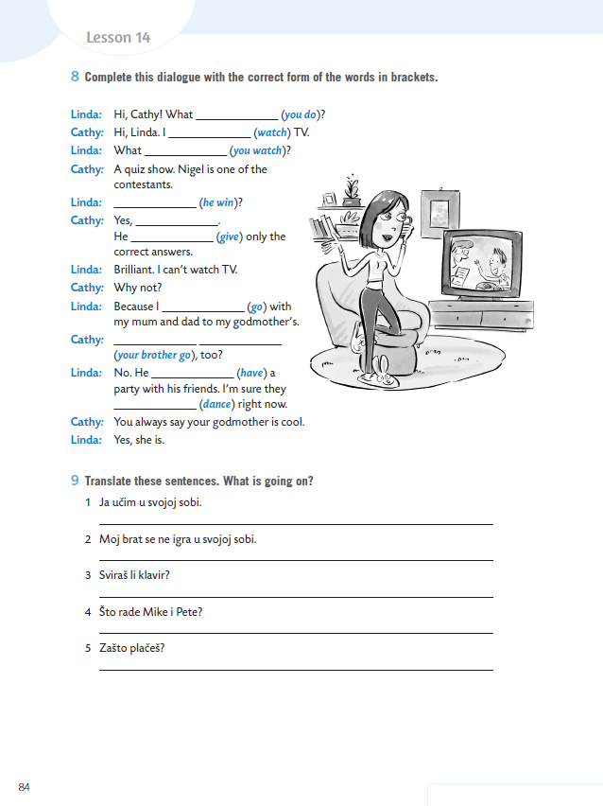
On the next page...
Complete this dialogue with the correct form of the words in brackets.
are you doing
am watching

Slide 26
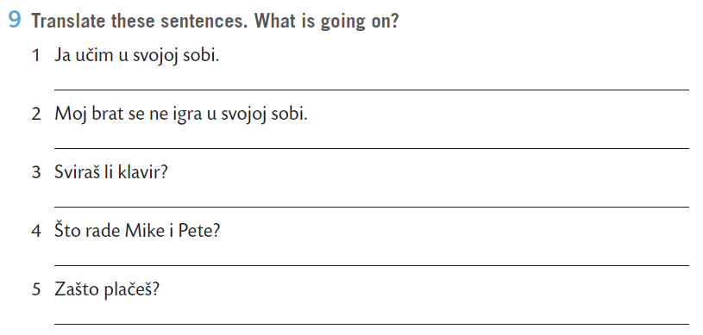
Translate these sentences. What is going on?
I am studying in my room.

Slide 27
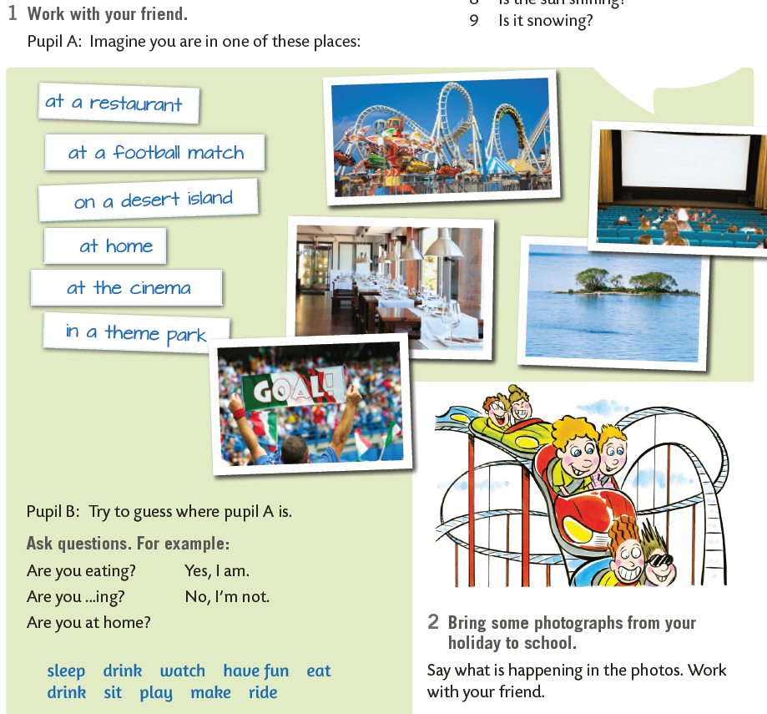

Go back to your book, page 85.
Imagine you are in one of these places, and then call one of your classmates and let him/her try to guess.

